Slide 1
L10.02+ (out of syllabus) Speed up Dijkstra’s
50.004 Introduction to Algorithm
Dr. Simon LUI
ISTD, SUTD

Slide 2
Introduction
As I mentioned, people are still
Using Dijkstra’s
Improving Dijkstra’s
Today I will show you one common technique to improve the running time of Dijkstra’s

Slide 3
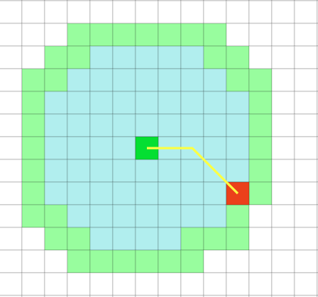
Speeding up Dijkstra’s algorithm
Most of the searches: source s to destination t
Obvious: stop search when t is removed from Q
Simple model: assume a b-branching structure, edges of length 1
Dijkstra explores all
possible directions
in increasing
distance from s
t

Slide 4
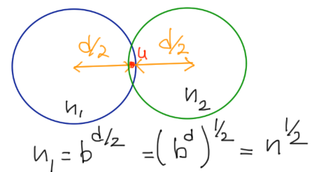
Bi-directional search
s
t

Slide 5
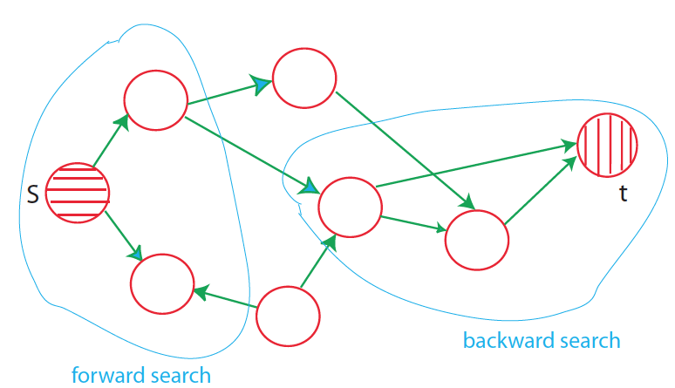
Bi-directional search
estimated distance
in search from s, t
Bidirectional search: perform in parallel
Search forward from s with Dijkstra (S_{s} : decided nodes, v.s)
Search backwards from t with Dijkstra (S_{t}: decided nodes, v.t)
Stop when some node u has been placed in both S_{s} and S_{t}
Check for node x with minimum value of x.s + x.t, then start again

Slide 6
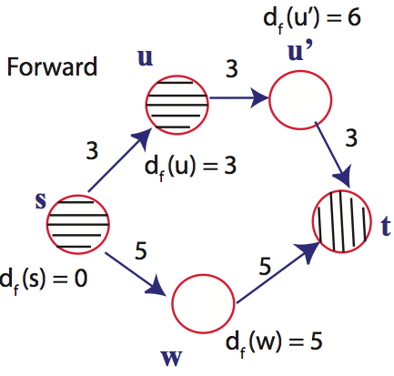
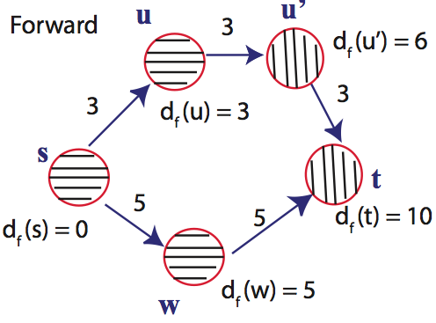
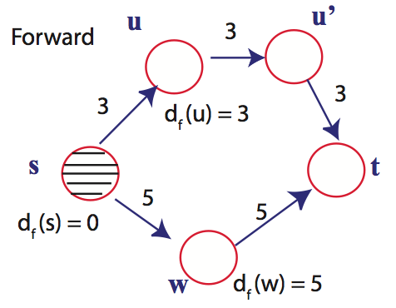
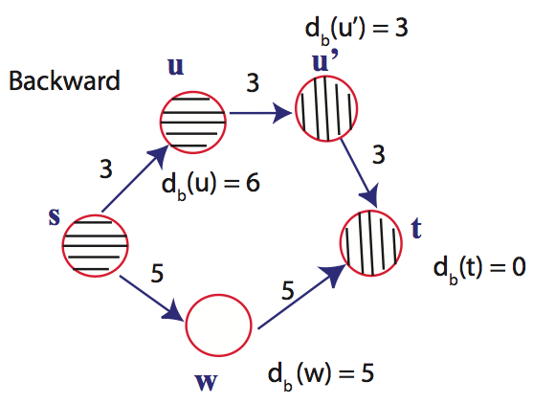
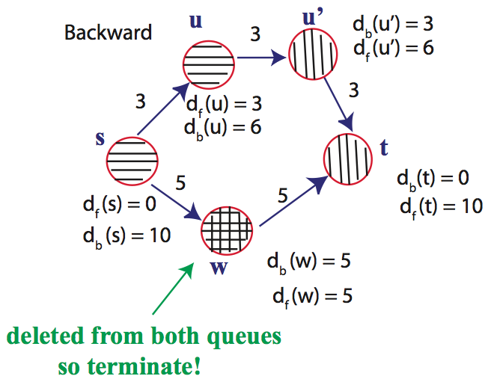
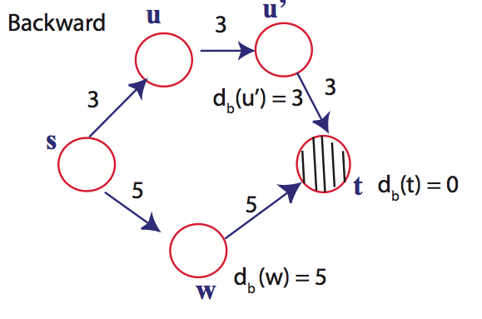
Notes:
Ask about shortest path

